Slide 1
IntelliCheck Your AI Exam Correction Assistant
By Team AutoRegressive Alliance

Slide 2
Table of contents
1
Introduction
2
Pipeline
3
Test Cases
4
Future Plans
Our basic functionality
Our machine learning pipeline
View some of the test cases for our application
How we aim to grow this application in the future

Slide 3
1
Introduction
How can we help teachers ?

Slide 4



Introduction
Correct Answer Scripts
Gives Feedback
Custom Marking Schemes
IntelliCheck scans the answer scripts and corrects them
Students get personalised feedback on why their answers
Define your own marking scheme

Slide 5
PipeLine
2
How we do it ?

Slide 6






PipeLine
Student Script Picture
Image Pre-Processing
Handwriting OCR
Named Entity Recognition
Sample Answer
Score and Feedback
Synonym Checking
Verb Recognition

Slide 7
3
Test Cases
See our app in action

Slide 8
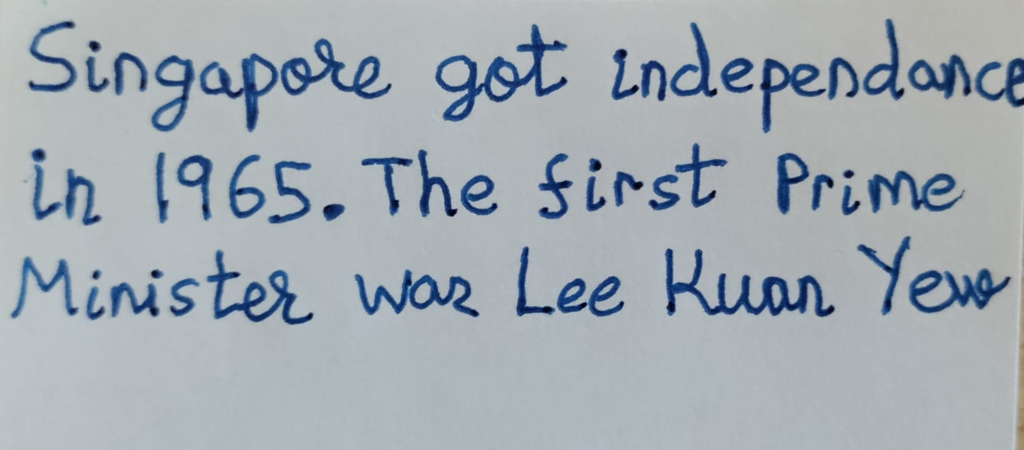
Test Cases
Question: Which year did Singapore gain independence ? Who was the first prime minister ?
Marking Scheme:
2 Marks Total
‘1965’
‘Lee Kuan Yew’
Student Answer:
Results:
This answer gets: “2"
The errors are:

Slide 9
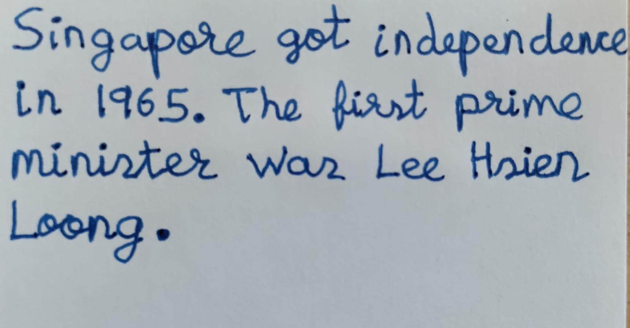
Test Cases
Question: Which year did Singapore gain independence ? Who was the first prime minister ?
Marking Scheme:
2 Marks Total
‘1965’
‘Lee Kuan Yew’
Student Answer:
Results:
This answer gets: “1"
The errors are: You didn’t include the PERSON ‘Lee Kuan Yew’

Slide 10
4
Future Plans ?

Slide 11
Future Plans
UpScale
1
Support for multiple questions and exams
More Feedback
2
Generates detailed pdf report for feedback
Analytics
3
Detailed Analysis Report for the Teacher

Slide 12
Thanks!
Team: AutoRegressive Alliance
Harsh Rao Dhanyamraju
Sanskar Malavade
Kshitij Parashar

